Slide 1
Senior Design Project A ROBOT TO Autonomously locate and transport severe disaster victims to care facility
TEAM 6:
TEAM MELTDOWN

Slide 2
Objectives
4 wheel autonomous robot.
Navigate self through flat and grassy terrain without damaging board.
Navigate board without crossing “river”.
Locate victims, pick them up, and return them to a drop-off point.
Return victim to correct drop-off point based on color.
Return to home location.

Slide 3
Who We Are ? – The Team Meltdown
Mansi Shah [Electrical/Power]
Taylor Morrissey [Mechanical]
Shayan Bani Ardalan [Sensors/Navigation]
Jacob Nehgen [Embedded/Control]
Collin MacDonald [Programming]

Slide 4
Where Did We Start?
Good Foundation plays a key role in the success of any engineering project, so we started with finding a good foundation for our robot, the chassis.
Things We Kept In Mind While Searching Chassis :
Appropriate size to provide required agility to take necessary turns as well as to fit in paths.
Ability of motors and wheels to allow robot to operate on both paved and non-paved (grass like) surface.
Enough slots to mount Power supply, sensors, gripper and Micro Processor/controller board.
And we Landed our choice on…….

Slide 5
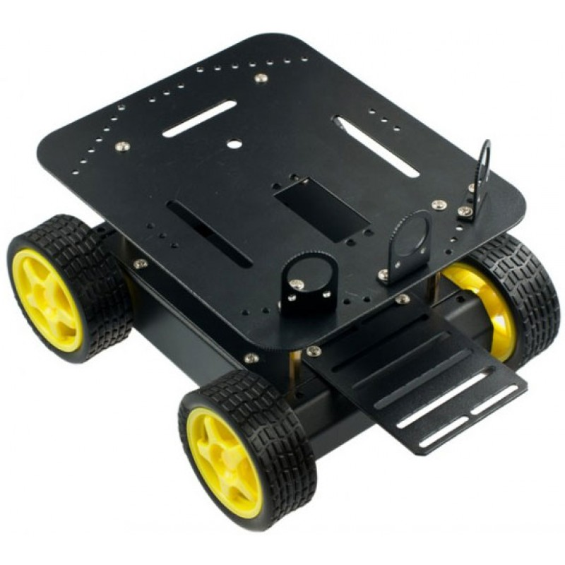
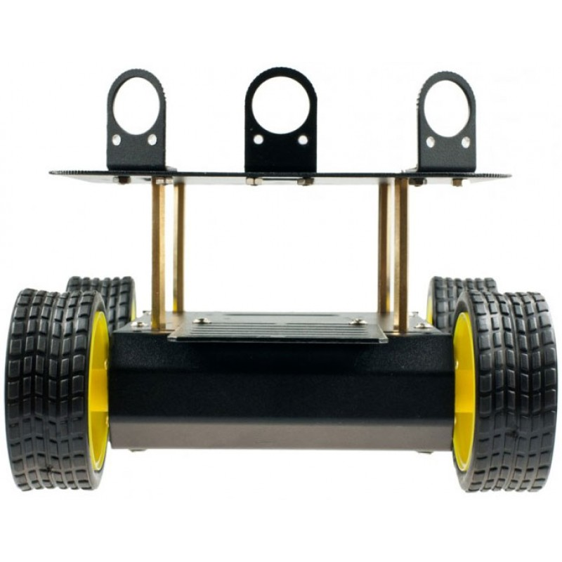
DFRobot 4WD Arduino Mobile Platform
Comes with 4 motors which can operate at its maximum speed on 6V power supply.
Has front mounting slots for gripper.
Wheels can work on normal and grass like surface.

Slide 6
Electrical / Power
We need to power up various components in our circuit like Motors, sensors, Arduino, raspberry pi 2, gripper motor, Aurduino motor shield
As Both motors on left would always operate on same direction we decided to fuees it together in parallel to make left and right unit.
Here is the high level circuit diagram to illustrate all power connections

Slide 7
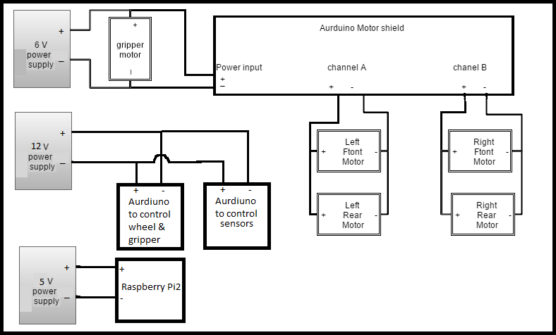

Slide 8
Mechanical/assembly
Chassis
Gripper
Modification of chassis for preferred gripper location
Will mount all circuitry and sensors in desired placement
Soldered connections to motors for power

Slide 9
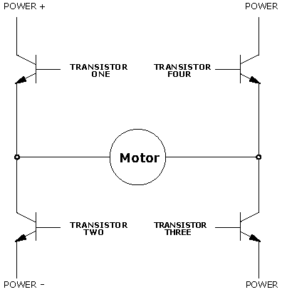
What Will We Design?
H-Bridge
4 NMOS transistors
Write high or low to reverse movement of servo
1 H-bridge for each side of the robot

Slide 10
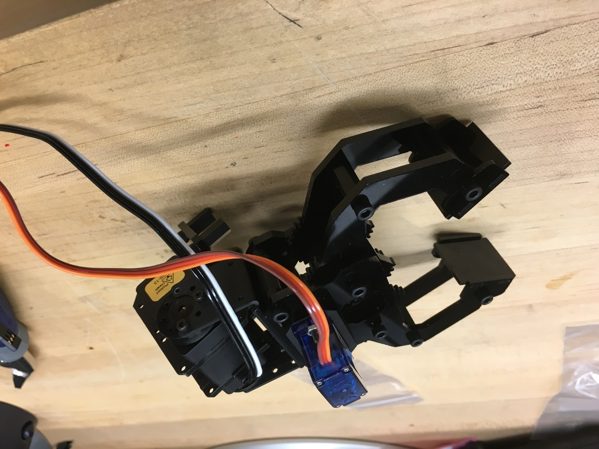
Gripper

Slide 11
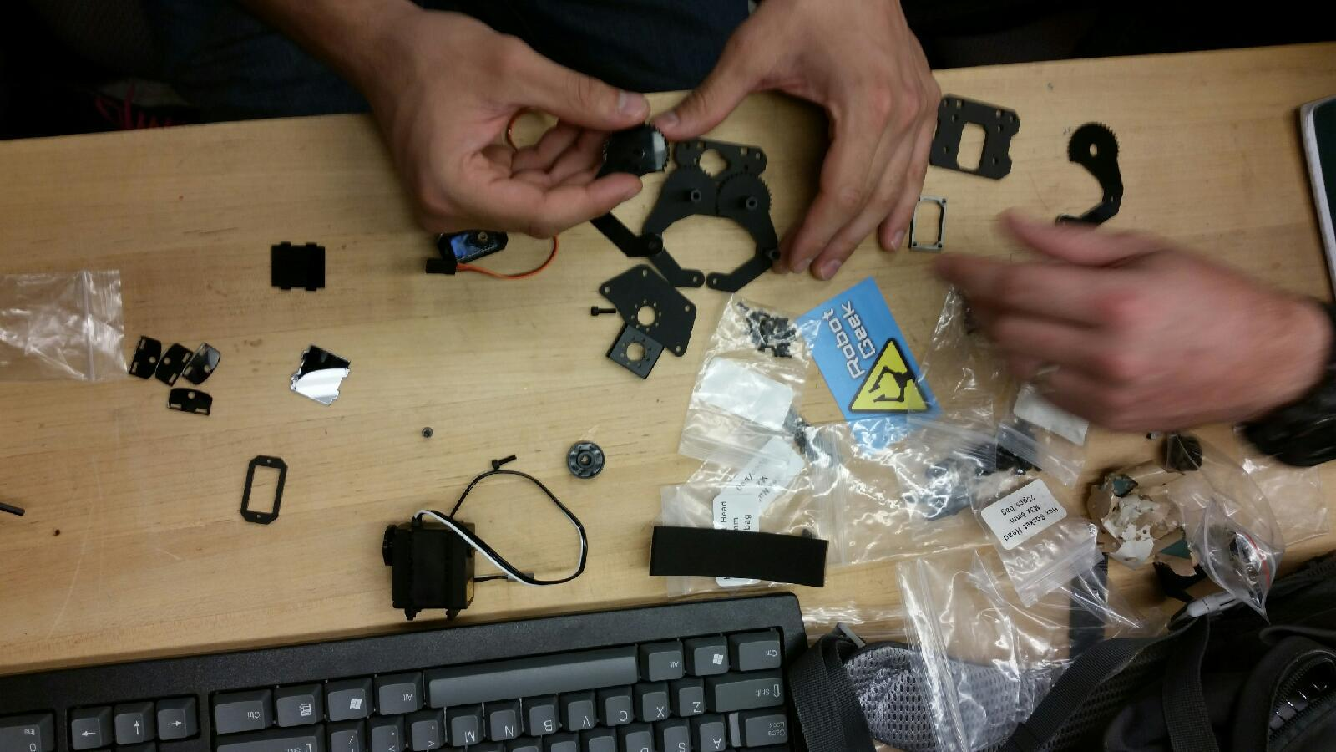

Slide 12
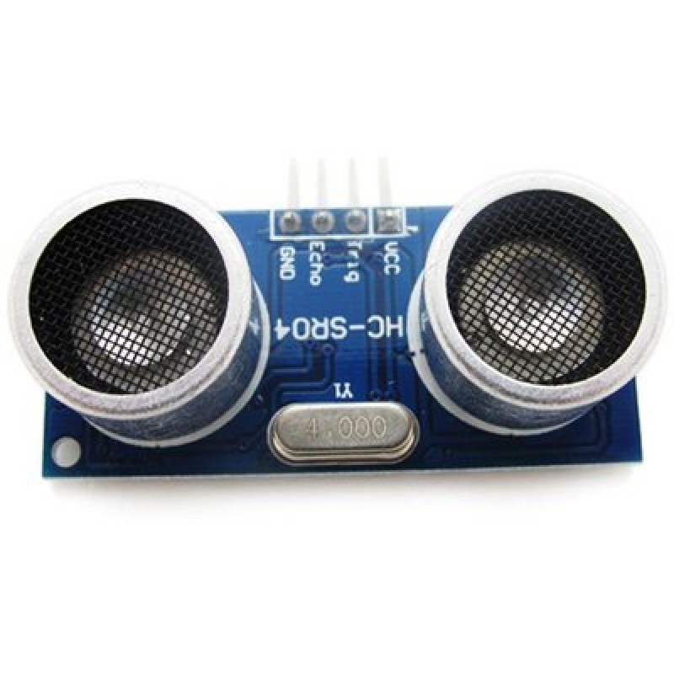
Sensors / Navigation
We used HC-SR04 Ultrasonic Range Finder sensors to get feel of object/obstacles around robot.
Initial plan was to use sensor with raspberry pi2 but it turned out writing code in Arduino is much simpler
We started off with writing simple test code which checks how far is object from sensor. we placed wooden block at various distance from sensor and measured its distance using sensor and results were almost accurate.

Slide 13
Embedded
2 Arduino boards
More I/O pins
More processing power
1 Arduino for sensor inputs
1 Arduino for controlling motors
1 Raspberry Pi2 with Camera Module for color sensing.
We can use Mega Arduino board instead of two Arduino Uno’s to avoid asynchronous processing.
Motor
HC-SR04 Sensors
Camera Module
Arduino 1with Motor Shield
Arduino 2
Pi 2
Gripper

Slide 14
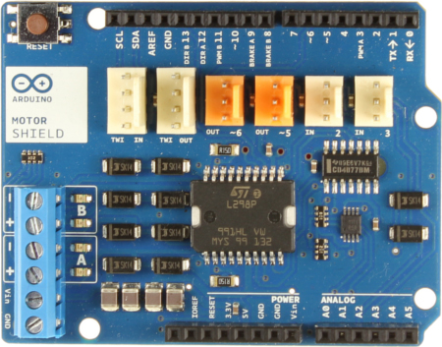
Arduino Motor Shield

Slide 15
Programming (So Far)
Arduino script for controlling wheels.
Arduino script for controlling gripper.
Arduino script for printing distance to Arduino Serial Monitor from HC-SR04 sensor.

Slide 16
Programming (In Progress)
Communication between Arduino boards
Communication between Arduino board and Raspberry Pi 2
Python application for color sensing

Slide 17
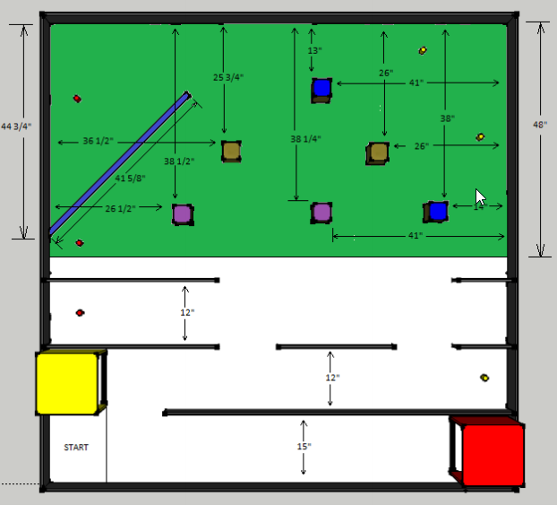
Final Behavioral Overview
2
1

Slide 18
Projected Cost
Sr. | Item | Cost
1 | Chassis | $100
2 | Gripper | $75
3 | Sensors | $25
4 | Control Boards | $50
5 | Track Construction | $50
6 | Batteries | $20
 | Projected Total | $320

Slide 19
Actual Itemized Cost
Sr. | Item | Cost
1 | Chassis | $75
2 | Gripper | $55
3 | HC-SR04 Sensors | $6
4 | Arduino Motor Shield | $23
5 | Raspberry Pi 2 | $35
6 | Camera Module | $30
7 | Edimax Wi-Fi USB Adapter | $10
8 | Track Construction | $44
 | Total | $278
Notes:
A schedule design for optional periods of time/objectives.

